Slide 1
Foundations of Automation
Clay Haynes

Slide 2
Who Am I?
Senior Network Security Engineer at Twitter
Juniper Ambassador
Dual JNCIE in Enterprise Route/Switch and Security

Slide 3
Topics
Why automation projects fail
What we can do about them

Slide 4
Why Automation Projects Fail
The needs of the Organization are poorly defined
Lack of information of the infrastructure
Lack of standards and templates
Scope creep

Slide 5
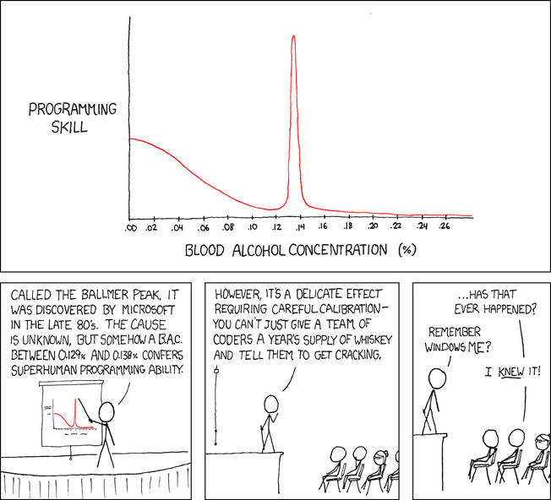
Why Automation Projects Fail
Source: XKCD

Slide 6
Organization Needs
Different groups are asking the different questions:
CISO - How do I show value to the org while maintaining best security practices?
Manager - How do I make sure my resources are utilized efficiently?
Engineer - How do I stop having to run the same task weekly/daily/hourly?
In essence, ‘What problem are you trying to solve’?

Slide 7
Organization Needs
Different questions can still be part of the same goal
Automating simple daily tasks can have significant impact:
A daily task which takes 30 minutes save a week’s worth of effort annually
A monthly task which takes a full day can save ~2 week’s worth of effort annually
These small optimizations add up quickly, but can drain resources unintentionally
Automating a 5 second task performed daily only saves 24 minutes annually

Slide 8
Organization Needs
Engineers:
Understand and communicate the tasks that take a significant amount of time
Automate tasks, not full jobs or functions
Use existing tools!
Managers:
Help your team to prioritize their tasks
Offer assistance in getting the right resources to automate tasks
Communicate up to the value of these tasks
Help developers and engineers avoid the ‘Not Invented Here’ syndrome
Executives:
Trust, but verify
Provide resources (training, infrastructure, time, buy-in) to support automation

Slide 9
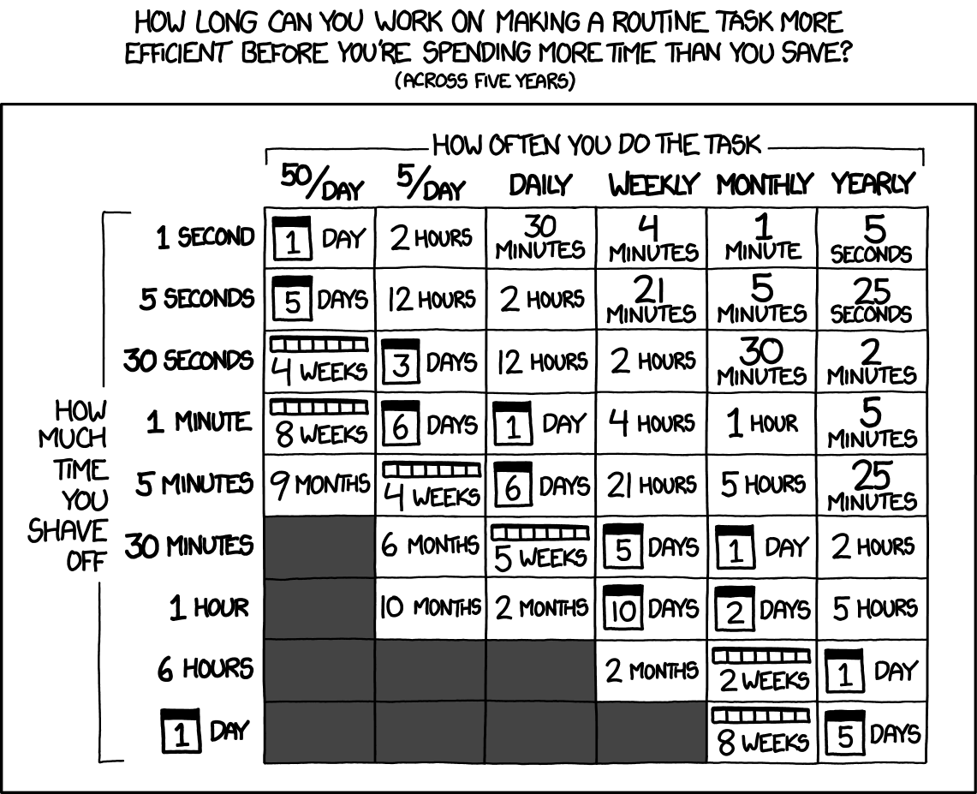
Organization Needs
Source: XKCD

Slide 10
Infrastructure Information
This is the largest common cause of automation failures
Each service, device, application is unique
Poor or nonexistent documentation on what goes into each service
Infrastructure is organized by group, not function

Slide 11
Infrastructure Information
Consider organizing infrastructure by roles and group:
DB.HR - Database for HR
DB.WEB - Database for Website
FS.CORP - File Server for Corp
FE.WEB - Front End for Website
Identify and document basic information in a central database
IP Addresses
Main IP
IPMI/OOB
Server location (Datacenter, Rack, Rack Unit, Cluster/Availability Group)
Hostname/FQDN
Make and Model
Service Owner

Slide 12
Infrastructure Information
Central Database - The Source of Truth™
For a Source of Truth to be usable it must contain the following attributes:
Easy to input information
A Web UI for non-technical users
CLI for power users
A script, using an answer file/CSV
Easy to query
A Web-based Report for informational uses (How many servers are the DB.HR Role?)
A CLI-based tool that can be scripted
Individual elements, such as IP addresses, can be pulled for a specific role

Slide 13
Infrastructure Information
When implementing security policies, consider the following:
Minimize the usage of subnets inside security policies
Use roles as a basis for policy enforcement
Add servers to roles
Use roles when applying policies, not individual servers
When using roles, it is much easier to add a server to a role than it is to re-order an entire firewall policy
Automating policies based on roles is easier than accounting for one-offs in code

Slide 14
Standards and Templates
Similar to the lack of information issue, lack of standards hurt automation efforts
One-off services can make automation a risky proposition
Lack of a standard naming convention in servers and security policies
Net1.company.com can be referenced differently than NET1.company.com
Services deployed manually often have differing software versions/patches

Slide 15
Standards and Templates
Each role defined should be very similar in form and function, if not identical
Tools such as Puppet, Chef, JAMF, and SCCM are critical here
Enforce a standard configuration and software package
Update configurations/software across the fleet/workforce
Highlight inconsistencies across servers
Treat applications more like cattle instead of pets
“Pet” applications must be constantly maintained
“Cattle” applications allows for faster tear-down and rebuilding of servers
This also makes moving applications to a cloud service much easier!
Create simple ‘blessed’ or blanket rules:
All host with the Web server role allow HTTP/HTTPS inbound
Corp users can always connect to any host in the Citrix Role

Slide 16
Scope Creep
Quite often, many initial projects are too ambitious
Jack of all trades, master of none
Increasing the number of features throughout the project
When too many things are wanted at the start, nothing ever gets completed
Engineers will often try to automate a full job function versus a single task

Slide 17
Scope Creep
Focus on a single task at a time
Consider starting with monitoring automation
Pulling all link states on devices
Checking to see if routes/network topology has changed
Adding a feature your NMS lacks
Use existing tools whenever possible

Slide 18
Scope Creep
Move horizontally across a large project
For a network device or firewall, automate adding a single infrastructure service first:
DNS/NTP/SNMP servers used for name resolution/time synchronization/monitoring
Creating/Deleting servers in a firewall configuration
Adding/removing servers from a role/function
Combine all three tasks together - new networking provisioning tool
For a service or application
Automate the shutdown and removal of a server from a service
Automate ‘kicking’ (re-installing) a server from scratch based on role
Combine both tasks together - new server provisioning tool
Combine the provisioning tools together - new deployment times are greatly reduced!

Slide 19
In Summary
Focus on ‘What problem are we trying to solve?’
Start on individual tasks and build up from there
Have a usable/searchable repository of information - The Source of Truth™
Develop, implement, and enforce standards and template

Slide 20
Thank you!
Juniper Networks
Information Security Summit
You!

